Slide 1

Customer churn prediction
https://www.google.com/url?sa=i&url=https%3A%2F%2Funsplash.com%2Fs%2Fphotos%2Fcolor&psig=AOvVaw1TfTH_A8JgQ7le0lArXv0G&ust=1698844659718000&source=images&cd=vfe&opi=89978449&ved=0CBIQjRxqFwoTCKjI-NGvoIIDFQAAAAAdAAAAABAE

Slide 2
Importing the files:-
In this we will import all the necessary filles and directories which will be required to perform the operations over the database.
We will clean the data , perform feature engineering on the data ,applying visualization for better understating of the data then will build a model for further predictions.

Slide 3
Data cleaning:-
In this step from the present data that we have we will try to clean the data by removing any sort of duplication in the data, unknown data ,null data etc so that our data becomes ready for further operation . Here we will also perform some opoerations like encoding ,finding dimensionality of the data then finding any null values in the database then removing the data which is not useful for any further operations etc.

Slide 4
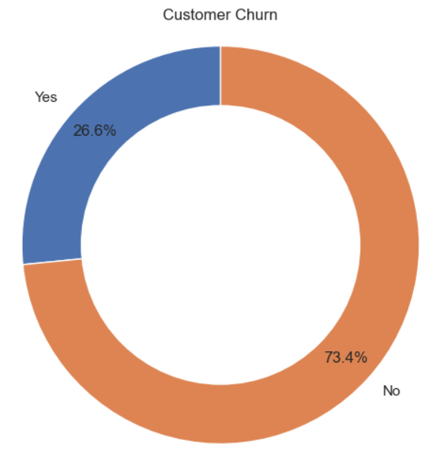
visulazation
After cleaning the data we will visualize our present data so that we get the insights from the data and help us to move in a certain directions.
Here we get some insights like 26.6 percent people have cancelled there subscription and remaining haven’t.

Slide 5
In the next step we will perform some random things like grouping the data so that we will get more knowledge on the churn column
We will get to know that out of 26.6 percent of cancellations majority are non-seniors.
Now we will find the churn distribution with respect to the dependencies. Because low dependencies will tell us which customers have high changes of churning. These cutomers are not invested in phone company’s services.

Slide 6
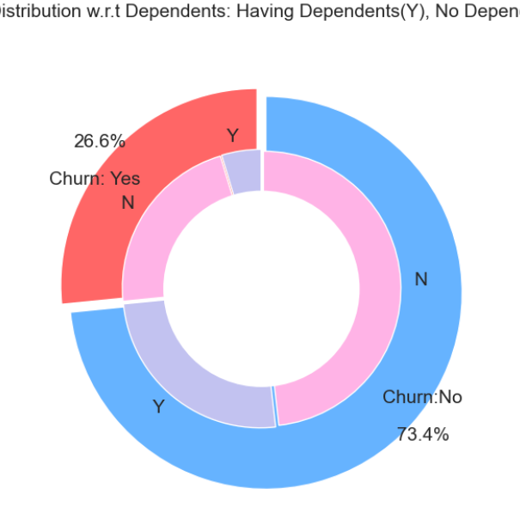
From this chart we will get to know how the dependent customers have less change to churn..
Now we will find if the churning is done by partners or singles.

Slide 7
From the next visualization we got to know that there are nearly 30% people who are partners or have partner are churing .and remaining are the single people who are churning.
Now we will perform several operations over several columns to find the reason for churning.
Customer with monthly contracts are more likely to churn then annual customers.
Customer with better tech support,online security ,online backup and customer with a single single ISP are less like to churn.

Slide 8
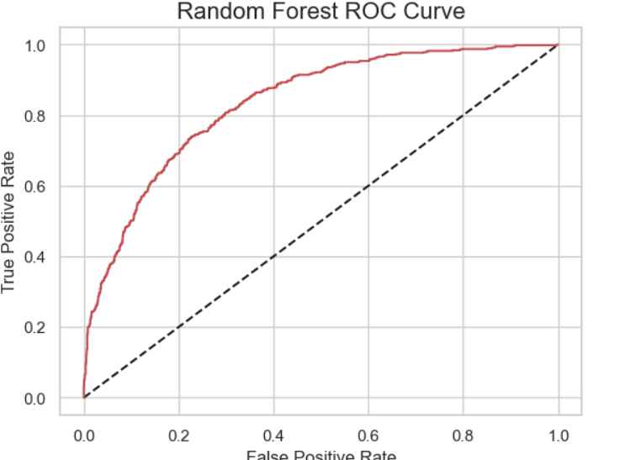
ROC CURVE
Atlast we will train our model with the data and to find the Roc curve for the model.

